Slide 1


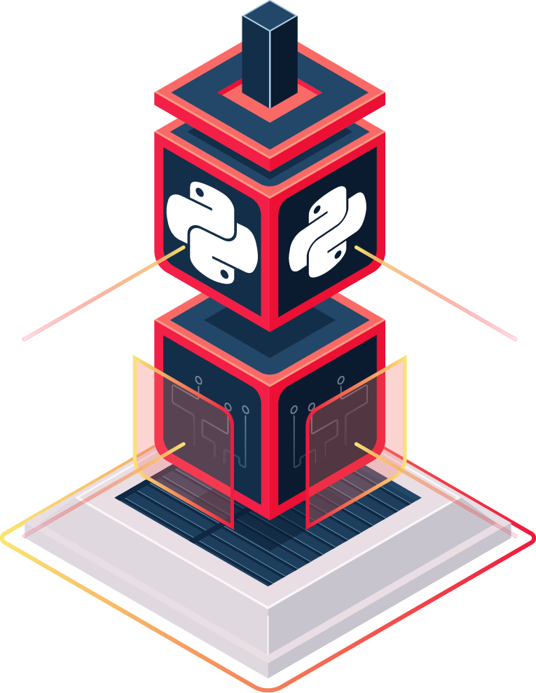

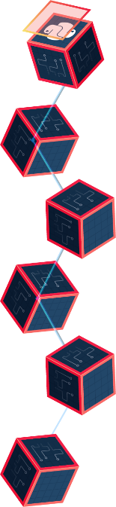

PyChain – A simple Blockchain made with Python that allows secure sharing of anything with anyone.
By: Raul Contreras Soriano & Oluwagbenga Ogungbemi
PyChain Repository:
https://github.com/ksu-hmi/KSU-PyChain
Repositories and Collaboration:
https://github.com/satwikkansal/python_blockchain_app - satwikkansal
https://github.com/adilmoujahid/blockchain-python-tutorial - adilmoujahid
https://github.com/dvf/blockchain - dvf
https://github.com/anders94/blockchain-demo/ - anders94
https://github.com/julienr/ipynb_playground/blob/master/bitcoin/dumbcoin/dumbcoin.ipynb - julienr
https://github.com/dlitz/pycrypto - dlitz

